Slide 1
BUILDING A CHATBOT
Northeastern University
EAI 6010 Application of AI
Shivam Chauhan And Shubham Pratap Singh

Slide 2
What is a Chatbot ?
A chatbots special ability is its ability to converse with humans, hence the knowledge of chatting with someone is key for a chatbot.
The purpose of chatbots is to scale business teams and help them in maintaining a cordial relationship with their customers.
This helps businesses cut down on operational costs, save time and ensure lucrative productivity as all the basic and monotonous requests are handled by the chatbot while complex queries are taken care of by the support team.

Slide 3
Why Chatbots are used?
Gather Customer Information
Increase sales
Available 24/7
Save Money
Improve Customer Satisfaction

Slide 4
Challenges
Lack Emotions
Difficult to create
Made to handle first-level question
Require Maintenance.

Slide 5
Technology used
Python
Natural Language Processing
Natural Language Toolkit (nltk) library
Machine Learning/Deep Learning
Artificial Neural Network using Keras library

Slide 6
Pipeline for creating a chatbot
Importing and loading the data file
Preprocessing the data
Creating training data
Building the model
Predicting the response
Testing our model

Slide 7
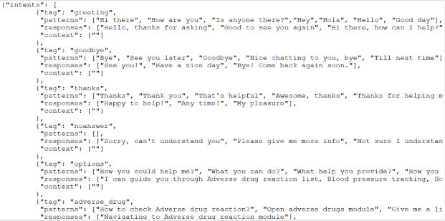
Data
The dataset that we have used is ‘intents.json’. This is a JSON (JavaScript Object Notation) file that contains the patterns that are essential to find and the responses we want to return to the user.

Slide 8
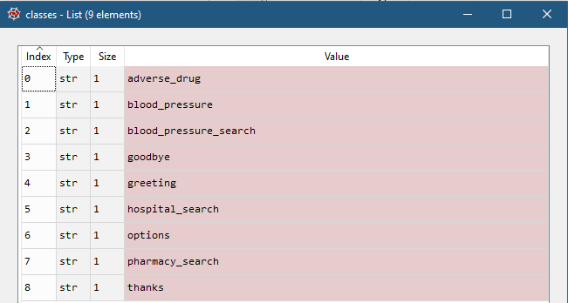
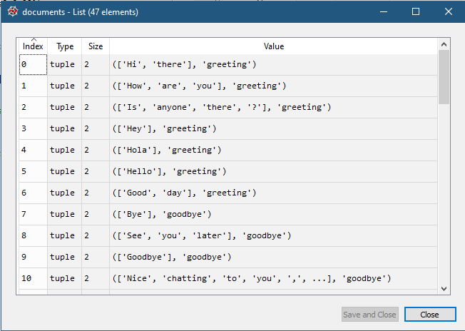
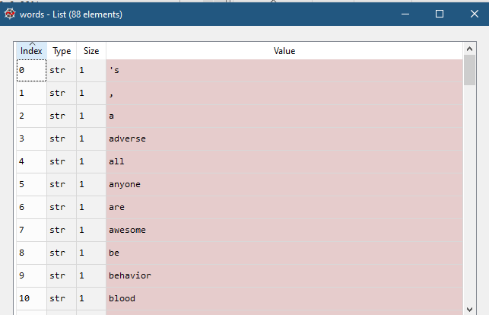
Data Pre-processing

Slide 9
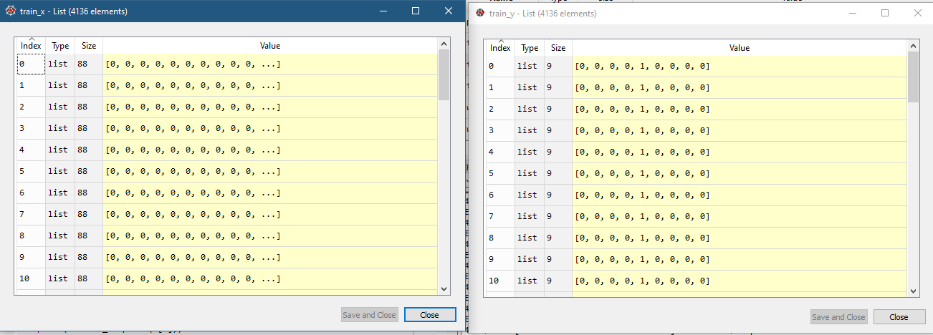
Training set

Slide 10
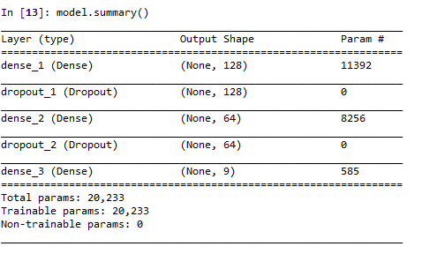
Model – Artificial Neural Network

Slide 11
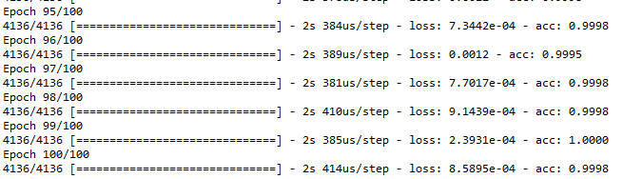
Model Accuracy

Slide 12
Prediction
let say our all the words list is [‘hello’, ‘hi’, ‘bye’, ‘thank’, ‘you’]
And our classes list is [‘greeting’, ’goodbye’, ‘thanks’]
So, if the input text is ‘Thank you’. Our input for model will be a list [0,0,0,1,1].
Our output of model will be [0,0,1]
Now our model will understand that it has to give a response from goodbye class. It will select a random response from the goodbye class in our data.

Slide 13
Testing
Working demo in spyder.

Slide 14
Thank you

